Slide 1
COLLEGE COMPLETION Dataset analysis
PROJECT FILE : COLLEGE COMPLETION DATASET ANALYSIS
PRESENTED BY:
SHUBHAM UPADHYAY

Slide 2
Introduction
This dataset contains detailed information about 3,798 colleges across the United States, with 49 attributes describing various aspects of each institution. Key features of the dataset include: 1. General Information: - College name, city, and state. - College level (e.g., 4-year or 2-year). - Type of institution (public, private, etc.). 2. Student and Institutional Statistics: - Total student count. - Percentage of full-time students. - On-time and late graduation rates. 3. Financial Data: - Average financial aid provided. - Endowment values. - Spending on awards. 4. Performance Metrics: - Median SAT scores and percentiles. - Retention rates. - Graduation rates (standard and transfer students). 5. Specialized Metrics: - Number of awards per 100 students and state. - Faculty metrics, such as full-time faculty percentages. - Enrollment and graduation data for transfer students. Some columns have missing values, such as median SAT scores, endowment data, and transfer graduation rates, which may require attention during analysis. The dataset provides a rich resource for exploring trends in higher education, assessing institutional performance, and making comparative analyses between colleges.

Slide 3
Download the CSV file from the website and upload it to Google Colab. Begin the data cleaning process by removing any unnecessary columns in the file. Next, identify any null values and address them appropriately. Check for outliers in the data set. Finally, analyse the dataset to extract key findings and create visual charts to represent your analysis.
Objective

Slide 4
Key Question
1. | What is the average graduation rate across all colleges in the dataset?
2. | Is there a correlation between the student count and the on-time graduation rate?
3. | How does the average financial aid students receive vary across different states?
4. | What is the distribution of expenditure on awards for colleges?
5. | Is there a relationship between the percentage of full-time students and the on-time graduation rate?
6. | Which state has the highest average awards per 100 students?
7. | How does the type of college control influence the on-time graduation rate?
8. | Is there a relationship between the college type and the average retention rate?
9. | What is the average student count for colleges in each state?
10. | Which colleges have the highest average awards per 100 students?

Slide 5
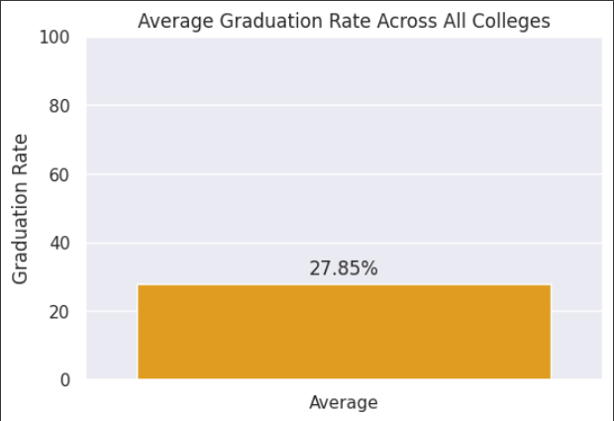
This bar graph is titled "Average Graduation Rate Across All Colleges." The vertical axis represents the graduation rate, ranging from 0 to 100 per cent, while the horizontal axis indicates a single category labelled "Average." A single bar extends from the horizontal axis to a height of 27.85%, visually representing the average graduation rate across all colleges. This suggests that, on average, approximately 27.85% of students enrolled in these colleges complete their degree programs. The bar graph's simplicity highlights the stark reality of the average graduation rate. The relatively low percentage underscores the challenges many students face in completing their higher education, emphasising the need for interventions and support systems to improve graduation rates and ensure greater access to educational opportunities.
Avg. Graduation Rate?

Slide 6
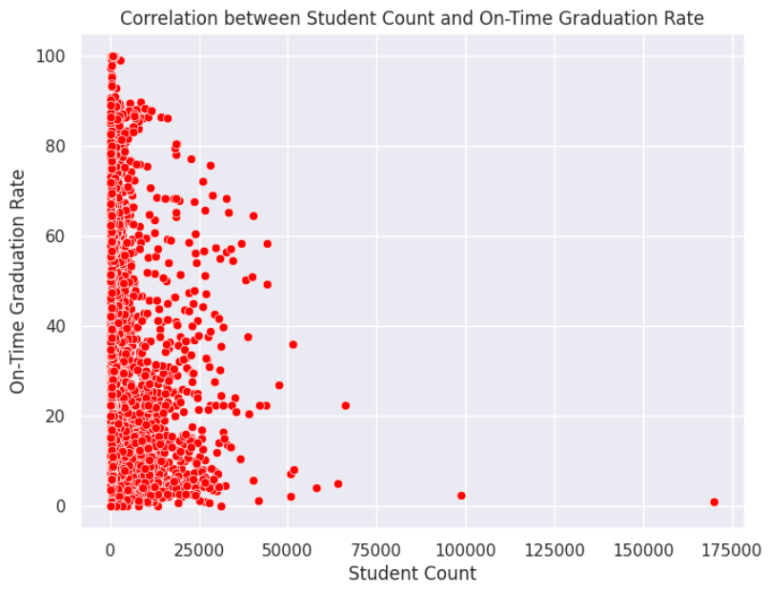
Student Count vs. Graduation?
The scatter plot titled “Correlation between Student Count and On-Time Graduation Rate.” The horizontal axis represents the student count, ranging from 0 to 175,000, while the vertical axis represents the on-time graduation rate, ranging from 0 to 100%. Each red dot on the plot represents a data point, where the x-coordinate corresponds to the student count of a particular institution, and the y-coordinate corresponds to its on-time graduation rate.
The scatter plot suggests a potential negative correlation between student count and on-time graduation rate. As the student count increases, there appears to be a tendency for the on-time graduation rate to decrease. This could indicate that larger institutions may face challenges in providing adequate support and resources to all students, potentially leading to lower graduation rates. However, it’s important to note that this is just a visual observation, and further statistical analysis would be required to confirm the strength and significance of this correlation.

Slide 7
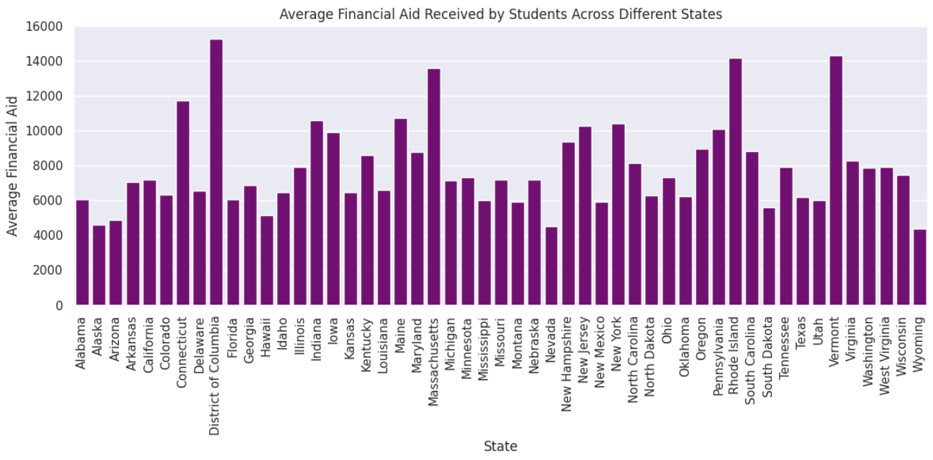
Financial Aid by State?
The chart illustrates the "Average Financial Aid Received by Students Across Different States" in the United States. The x-axis lists the names of all 50 states, along with the District of Columbia, while the y-axis measures the average financial aid amounts in dollars, ranging from 0 to 16,000. Each state is represented by a vertical purple bar, with the height of the bar corresponding to the average financial aid awarded in that state. Notable variations in aid amounts are evident, as some states have significantly taller bars, indicating higher average financial aid, while others have shorter bars, reflecting lower amounts. The distribution of financial aid appears uneven, with some states, such as Connecticut and the District of Columbia, showing the highest averages near or exceeding $14,000. In contrast, many states have bars clustered between $6,000 and $10,000, suggesting that this range is typical for most regions. This disparity likely highlights differences in state funding policies, the cost of education, or the availability of grants and scholarships across the country. The chart provides a clear and comparative visual representation of how financial aid varies geographically.

Slide 8
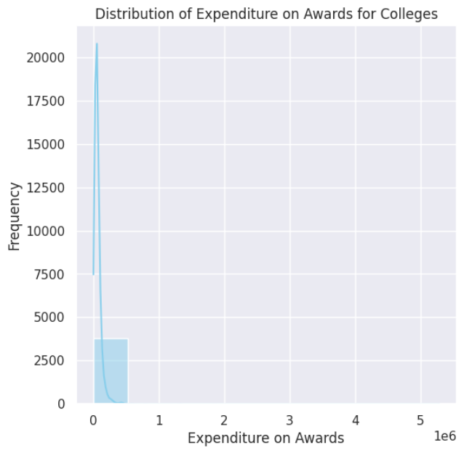
Award Expenditure?
The image presents a histogram titled "Distribution of Expenditure on Awards for Colleges." The horizontal axis represents the expenditure on awards, ranging from 0 to 5 million units (the units are not specified). The vertical axis represents the frequency, indicating how many colleges fall into each expenditure range. The histogram shows a distribution that is highly skewed to the right, with a long tail extending towards higher expenditure values. This suggests that a majority of colleges spend relatively small amounts on awards, while a smaller number of colleges spend significantly larger amounts.
The distribution is characterized by a sharp peak near the lower end of the expenditure range, indicating a high frequency of colleges with minimal expenditure on awards. As the expenditure increases, the frequency gradually decreases, forming the long tail. This pattern suggests that the allocation of funds for awards varies considerably among colleges, with some institutions investing substantially more than others.

Slide 9
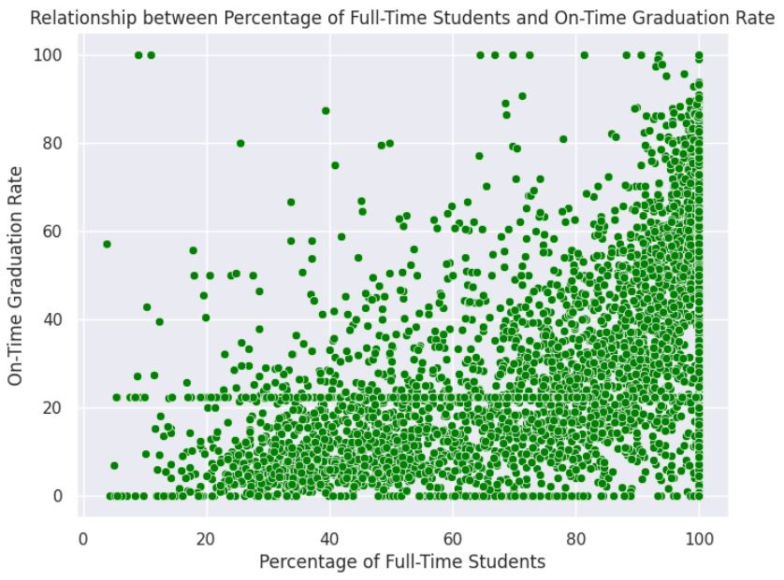
Full-Time vs. Graduation?
The provided image displays a scatter plot titled "Relationship between Percentage of Full-Time Students and On-Time Graduation Rate." The horizontal axis represents the percentage of full-time students, ranging from 0 to 100%. The vertical axis represents the on-time graduation rate, also ranging from 0 to 100%. Each green dot on the plot represents a data point, where the x-coordinate corresponds to the percentage of full-time students at a particular institution, and the y-coordinate corresponds to its on-time graduation rate.
The scatter plot suggests a potential positive correlation between the percentage of full-time students and the on-time graduation rate. As the percentage of full-time students increases, there seems to be a general upward trend in the on-time graduation rate. This could indicate that institutions with a higher proportion of full-time students may have an advantage in terms of student success and timely degree completion. However, it's important to note that this is just a visual observation, and further statistical analysis would be required to confirm the strength and significance of this correlation.

Slide 10
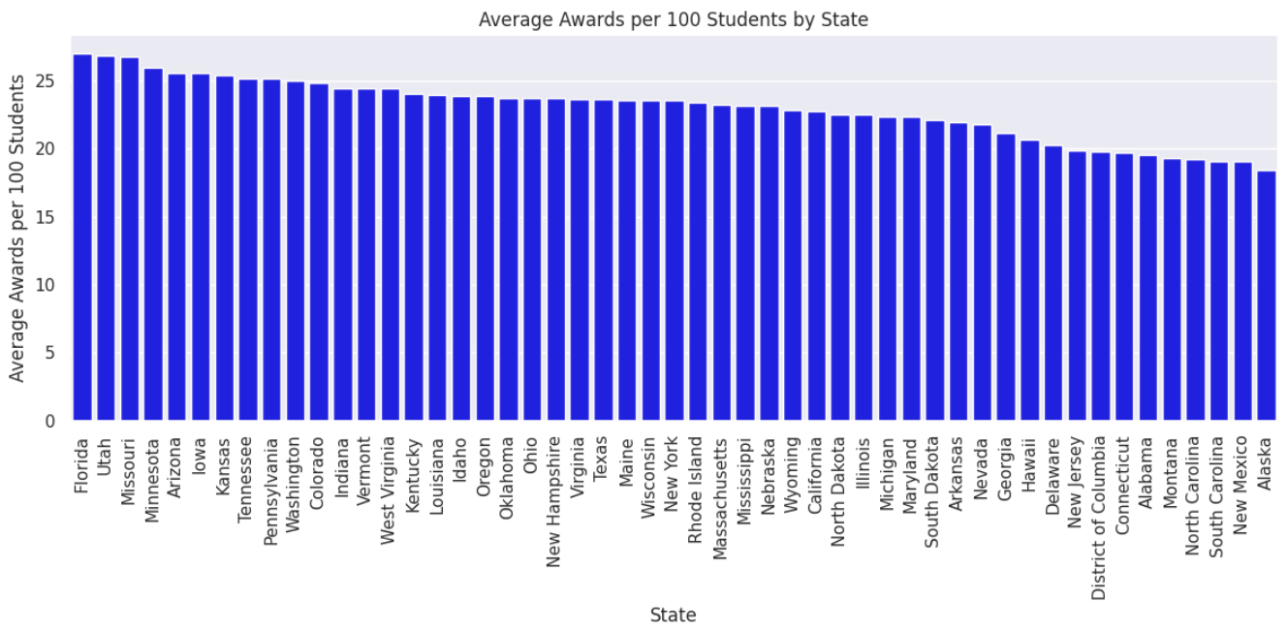
Top State: Awards/100?
The image presents a bar graph titled "Average Awards per 100 Students by State." The vertical axis represents the average awards per 100 students, ranging from 0 to 25. The horizontal axis displays the names of different states. Each bar corresponds to a state, and its height represents the average amount of awards received per 100 students in that state.
The bar graph shows significant variation in the average awards per 100 students across the states. Some states, such as Florida and Minnesota, have relatively high average awards per 100 students, while others, like New Mexico and Alaska, have much lower values. The states are arranged in descending order based on their average awards per 100 students, providing a clear visual comparison of the distribution of awards across the country.

Slide 11
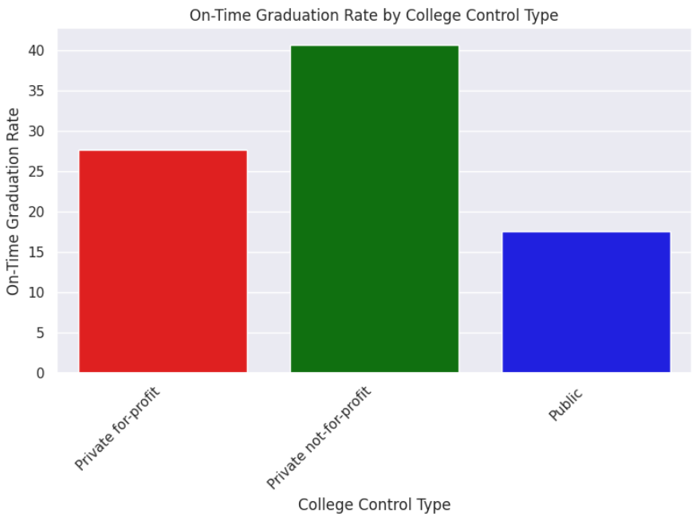
College Type vs. Graduation?
The provided image presents a bar graph titled "On-Time Graduation Rate by College Control Type." The horizontal axis categorizes colleges based on their control type: Private for-profit, Private not-for-profit, and Public. The vertical axis represents the On-Time Graduation Rate, ranging from 0 to 40%. Each coloured bar corresponds to a control type, and its height indicates the average on-time graduation rate for colleges within that category.
The bar graph reveals a clear disparity in on-time graduation rates across the different college control types. Private not-for-profit colleges exhibit the highest on-time graduation rate, with the bar reaching close to 40%. Public colleges follow with a moderate graduation rate, while Private for-profit colleges have the lowest rate, significantly lower than the other two categories. This visual representation highlights that the type of control a college operates under appears to have a considerable impact on its student outcomes, particularly in terms of timely degree completion.

Slide 12
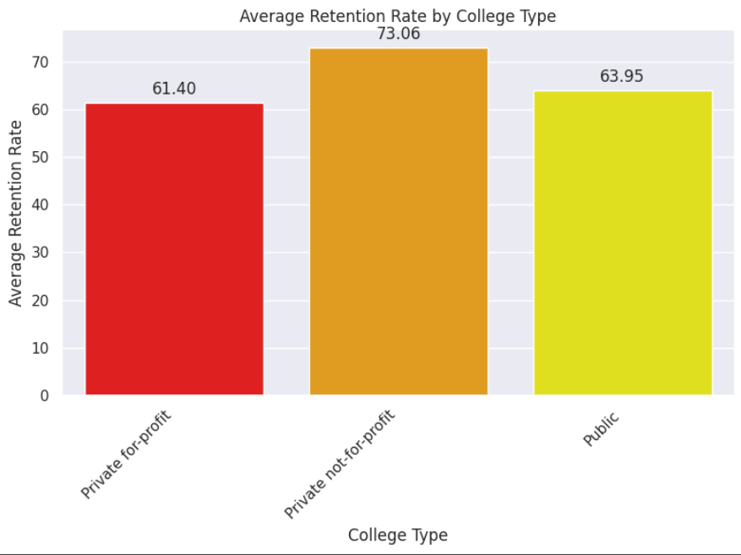
College Type vs. Retention?
The provided image displays a bar graph titled "Average Retention Rate by College Type." The horizontal axis categorizes colleges into three types: Private for-profit, Private not-for-profit, and Public. The vertical axis represents the Average Retention Rate, ranging from 0 to 70%. Each coloured bar corresponds to a college type, and its height indicates the average retention rate for institutions within that category.
The bar graph reveals a noticeable difference in average retention rates across the three college types. Private not-for-profit colleges showcase the highest average retention rate at 73.06%, followed by Public colleges with a rate of 63.95%. Private for-profit colleges exhibit the lowest average retention rate at 61.40%. This visual representation highlights that the type of control a college operates under appears to have a significant impact on its ability to retain students from one academic year to the next.

Slide 13
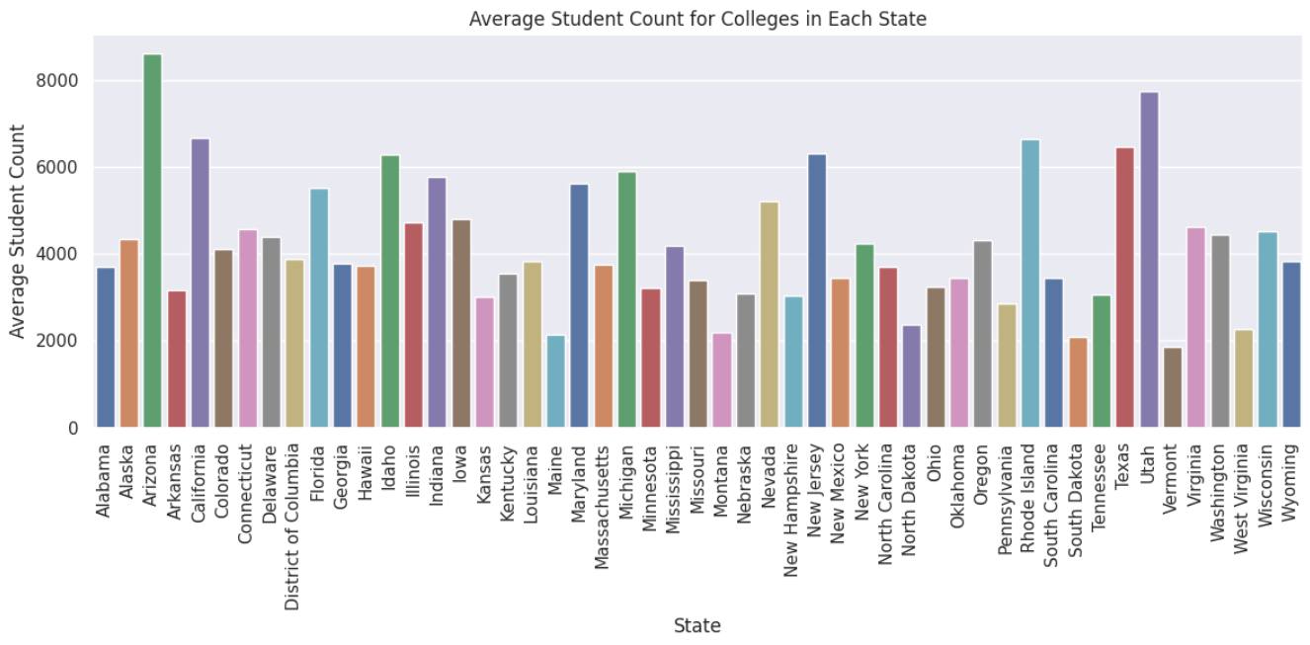
Avg. Student Count by State?
This bar chart represents the "Average Student Count for Colleges in Each State" across the United States, including the District of Columbia. Each state is depicted on the x-axis, while the y-axis displays the average student count, ranging from 0 to 8000. The data uses a multi-coloured bar representation to distinguish between states. The chart appears to emphasize state-level variations in the average student population across colleges, with some states exhibiting significantly higher averages compared to others. From the visualization, notable states like California and Texas seem to have higher average student counts, as their bars extend closer to the upper limit of the y-axis. In contrast, states like Vermont and Wyoming have relatively lower student averages, with their bars barely reaching the midpoint of the y-axis. The chart effectively showcases the diversity in college sizes across states but could benefit from annotations or labels to highlight specific insights, such as outliers or regional trends.

Slide 14
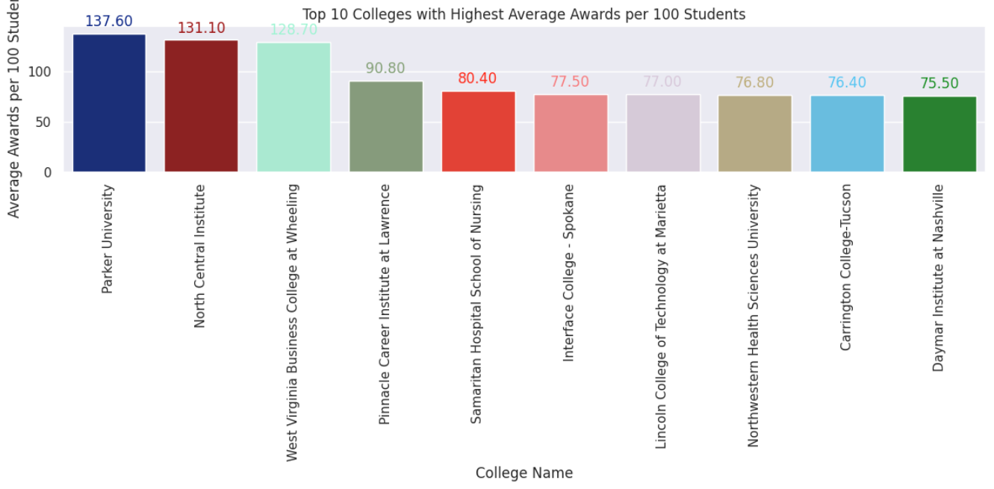
Top Colleges: Awards/100?
The provided image presents a bar graph titled "Top 10 Colleges with Highest Average Awards per 100 Students." The horizontal axis lists the names of the top 10 colleges, while the vertical axis represents the average awards per 100 students, ranging from 0 to 140. Each coloured bar corresponds to a college, and its height indicates the average amount of awards received per 100 students at that institution.
The bar graph reveals a significant variation in the average awards per 100 students among the top 10 colleges. Parker University stands out with the highest average awards, followed closely by North Central Institute. The remaining colleges exhibit a range of average awards, with some exceeding 100 and others falling below 80. This visual representation highlights the substantial differences in the level of financial support provided to students across these top-ranking institutions.

Slide 15
conclusion
This analysis of the College Completion dataset has revealed several key insights into factors influencing graduation rates and student success. The average on-time graduation rate across all colleges is around 27%, with variations observed based on factors like student count, financial aid, full-time student percentage, and college type. While a weak negative correlation was found between student count and on-time graduation rate, colleges with a higher percentage of full-time students tended to have slightly higher graduation rates. Variations in average financial aid received by students were observed across different states. Notably, the District of Columbia and Vermont had the highest average financial aid value. Colleges in different states also exhibited variations in average awards per 100 students and average student count. Public colleges tended to have higher on-time graduation rates compared to private nonprofit and private for-profit colleges. The average retention rates also varied across different college types. Finally, the analysis identified the top 10 colleges with the highest average awards per 100 students, highlighting institutions that prioritize award allocation and student support. These insights provide valuable information for stakeholders in higher education to understand factors contributing to student success and make informed decisions to improve outcomes. Further Analysis Further analysis could explore the relationship between college characteristics (e.g., faculty-to-student ratio, and academic programs offered) and student outcomes. Additionally, investigating the impact of specific student demographics (e.g., gender, race/ethnicity) on graduation and retention rates could provide a more comprehensive understanding of the factors influencing college completion

Slide 16
Thank you so much for your time

